Slide 1
SDAH 109-MARVELOUS GRACE ENGLISH TWI
Marvelous grace of our loving Lord.
Grace that exceeds our sin and our guilt!
Yonder on Calvary's mount outpoured
There where the blood of the Lamb was spilt.
Yεn Aw’rade dכfo dom nwanwa,
כdom a εb’ro yεn bכne so,
A wohwie guu Kalbre bepכ so
‘Hכna wohwiee ‘Guammaa mogya gui.

Slide 2
SDAH 109-MARVELOUS GRACE ENGLISH TWI
Refrain:
Grace, grace, God's grace,
Grace that will pardon and cleanse within
Grace, grace, God's grace,
Grace that is greater than all our sin!
Nnyeso:
‘Dom, ‘dom, ‘S’ro ‘dom,
‘Dom a εde bכn’ kyε, tew yεn mu;
‘Dom, ‘dom, ‘S’ro ‘dom,
‘Dom a εb’ro bכne nyinaa so.

Slide 3
SDAH 109-MARVELOUS GRACE ENGLISH TWI
Sin and despair, like the sea waves cold,
Threaten the soul with infinite loss;
Grace that is greater yes grace untold
Points to the Refuge, the mighty Cross.
Bכne ne abasamtu te sε
‘S’rכkye de כy’ra huna kra no;
כdom kεse, nea enni kabea
Kyerε yεn guankכbea ‘sεnnua no.

Slide 4
SDAH 109-MARVELOUS GRACE ENGLISH TWI
Refrain:
Grace, grace, God's grace,
Grace that will pardon and cleanse within
Grace, grace, God's grace,
Grace that is greater than all our sin!
Nnyeso:
‘Dom, ‘dom, ‘S’ro ‘dom,
‘Dom a εde bכn’ kyε, tew yεn mu;
‘Dom, ‘dom, ‘S’ro ‘dom,
‘Dom a εb’ro bכne nyinaa so.

Slide 5
SDAH 109-MARVELOUS GRACE ENGLISH TWI
Marvellous, infinite, matchless grace,
Freely bestowed on all who believe!
You that are longing to see His face,
Will you this moment His grace receive?
כdom nwanwa a enni kabea,
Wכde ma nea כgye di no kwa!
Mo a morep’re ahu N’anim,
So mobεgye Ne dom no seesei?

Slide 6
SDAH 109-MARVELOUS GRACE ENGLISH TWI
Refrain:
Grace, grace, God's grace,
Grace that will pardon and cleanse within
Grace, grace, God's grace,
Grace that is greater than all our sin!
Nnyeso:
‘Dom, ‘dom, ‘S’ro ‘dom,
‘Dom a εde bכn’ kyε, tew yεn mu;
‘Dom, ‘dom, ‘S’ro ‘dom,
‘Dom a εb’ro bכne nyinaa so.

Slide 7
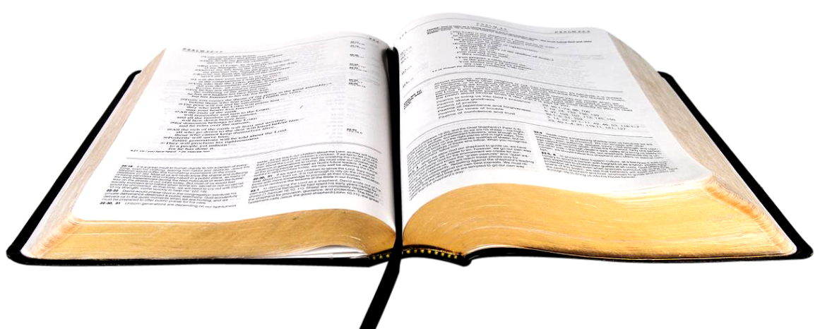
MY BODY: MY BEST GIFT TO GOD!

Slide 8
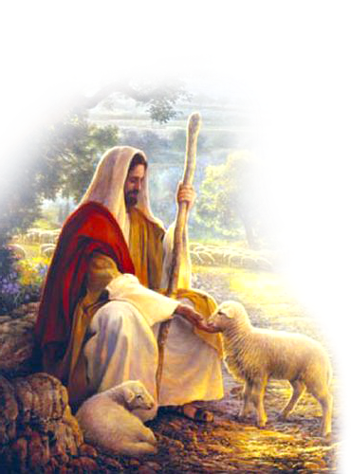
ROMANS 12:1
Enti anuanom, megyina Nyankopɔn mmɔborɔhunu so metu mo fo sɛ momfa mo nipadua nsi hu sɛ afɔdeɛ a ɛte aseɛ, a ɛyɛ kronkron a ɛsɔ Nyankopɔn ani, a ɛne mo nyamesom a adwene wɔ mu no.

Slide 9
The best gift any woman can give to a man is not money; it is not a car; it is not a house; it is not a 1000.00 Euro suit; it is her body.
A woman can steal money from another man and give to a lover; a woman can convince a rich friend to donate a car for a lover; a woman can borrow an expensive suit for a lover.

Slide 10
But there is one thing no woman can borrow, buy or steal from anyone to give to a man—her body.
It is the most expensive gift any woman can give to a man.
This is why God forbids raping, or fornication—giving your body freely to a man for no reason but lust.
Any woman who gives her body to a man for nothing stands condemned on God's judgment day.

Slide 11
Stop it if you are giving your body to aay man for free— 1 Cor. 6:13, 18, and 19.
Only a wife has the right to give her body to her husband!
In the spiritual sense, your body, my body is the property of God. God owns it even as a husband owns the body of his wife: 1 Cor. 7:4.
Because of the importance of our bodies, God has given specific commands as to what we should do and not do with our bodies.
Notes:
Verse 13 Aduane yɛ yafunu dea, na yafunu nso yɛ aduane dea, na Onyankopɔn bɛma ne mmienu ayɛ kwa. Na nipadua nyɛ adwamammɔ dea na ɛyɛ Awurade dea na Awurade yɛ nipadua dea.
Verse 18 Monnwane adwamammɔ! Bɔne biara a onipa yɛ nni nipadua mu, na deɛ ɔdɔ adwaman no deɛ ɔyɛ ɔno ara ne nipadua bɔne.
Verse 19 Anaasɛ monnim sɛ mo nipadua yɛ Honhom Kronkron a ɔwɔ mo mu, a monya firii Nyankopɔn hɔ no asɔredan, na monne mo ho?

Slide 12
1 Cor. 6:13, 18-19
Verse 13 Aduane yɛ yafunu dea, na yafunu nso yɛ aduane dea, na Onyankopɔn bɛma ne mmienu ayɛ kwa. Na nipadua nyɛ adwamammɔ dea na ɛyɛ Awurade dea na Awurade yɛ nipadua dea.
Verse 18 Monnwane adwamammɔ! Bɔne biara a onipa yɛ nni nipadua mu, na deɛ ɔdɔ adwaman no deɛ ɔyɛ ɔno ara ne nipadua bɔne.
Verse 19 Anaasɛ monnim sɛ mo nipadua yɛ Honhom Kronkron a ɔwɔ mo mu, a monya firii Nyankopɔn hɔ no asɔredan, na monne mo ho?

Slide 13
Yield (give up freely, give way for use) to God: Romans 12:1; Romans 6:13-14. By giving your body to God, it becomes His.
Make it as a living sacrifice: Romans 12:1. Keep it neat and clean and prepare it as a gift for God—like a wife preparing for her husband.
Make it holy: 1 Cor. 3:17. The recipient is a holy God so don't give any stained gift to Him. 1 Peter 1:14-16. Make your body fit for the Holy Spirit to dwell in. Holiness is wholeness to God. It means all for Christ.

Slide 14
Make it acceptable to God: Rom. 12:1-2. No husband wants a dirty wife in the marriage bed. God does not want any dirty body. Cleanse it by the blood of Christ daily with faith, prayer, and bible study.
Make it full of light by exposing it to the Light of the word through Bible study and prayer spending time with God: Matthew 5:14; 6:22.
Reckon it as dead to sin but alive to God: Rom. 6:11. This is done during baptism when the Three Great Powers of the Universe witness your decision to join the holy family of God.

Slide 15
Refuse its slavery to sin—to be abused by anybody for anything: Rom. 6:12.
Refuse to defile it: 1 Cor. 3:17. Tell that man, that boy to take his filthy hands off your body, because it is for Christ.
Mortify; that is to humiliate or undergo discipline; fight anybody or anything that wants to abuse your body—even a husband: Rom. 8:13.

Slide 16
Make it free from fornication and only for the Lord: 1 Cor. 6:13-20.
Keep it in control: 1 Cor. 9:27. Don't allow your body to control you! Put off its sins or desires: Col. 2:11.
Glorify God with your body: 1 Cor. 6:20; Rev. 14:6. Let God be proud of your body.

Slide 17
Let Satan fear your body!
Respect yourself!
Stand before the mirror and admire yourself.
Feel proud of yourself!
Each day, wash this body and decorate it as a special gift to God.

Slide 18
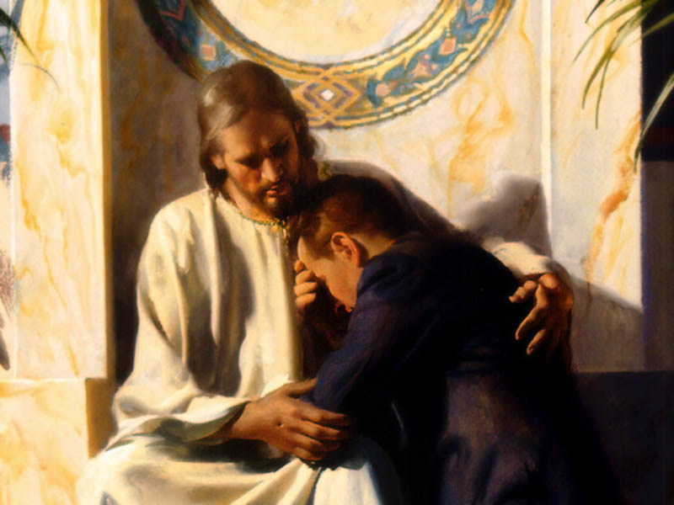

Slide 19
SDAH 309 I SURRENDER ALL ENGLISH TWI
All to Jesus I surrender,
All to Him I freely give;
I will ever love and trust Him,
In His presence daily live;
Migyaw ne nyinaam’ ma Yesu,
Mede neny’naa ma No kwa;
Daa mεdכ No, matwere No,
Atra N’anim hכ daa daa.

Slide 20
SDAH 309 I SURRENDER ALL ENGLISH TWI
Refrain:
I surrender all,
I surrender all;
All to Thee, my blessed Saviour,
I surrender all.
Nnyeso:
Migyaw ne nyinaam’,
Migyaw ne nyinaam’;
Ne nyinaa ma W’
‘Gyenkwa Dεεfo,
Migyaw ne nyinaam’.

Slide 21
SDAH 309 I SURRENDER ALL ENGLISH TWI
All to Jesus I surrender;
Humbly at His feet I bow,
Worldly pleasures all forsaken;
Take me, Jesus, take me now.
2. Migyaw ne nyinaam’ ma Yesu,
Koto komm Ne nan ase;
Magyaw wiase ‘nigye nyinaa,
Fa me, Yesu fa me nnε.

Slide 22
SDAH 309 I SURRENDER ALL ENGLISH TWI
Refrain:
I surrender all,
I surrender all;
All to Thee, my blessed Saviour,
I surrender all.
Nnyeso:
Migyaw ne nyinaam’,
Migyaw ne nyinaam’;
Ne nyinaa ma W’
‘Gyenkwa Dεεfo,
Migyaw ne nyinaam’.

Slide 23
SDAH 309 I SURRENDER ALL ENGLISH TWI
All to Jesus, I surrender;
Make me, Savior, wholly Thine;
Let me feel the Holy Spirit,
Truly know that Thou art mine.
Migyaw ne nyinaam’ ma Yesu,
‘Gyenkwa, ma menyε Wo de;
Ma mente Honhom Kronkron nka,
Na menyε Wo de ampa.

Slide 24
SDAH 309 I SURRENDER ALL ENGLISH TWI
Refrain:
I surrender all,
I surrender all;
All to Thee, my blessed Saviour,
I surrender all.
Nnyeso:
Migyaw ne nyinaam’,
Migyaw ne nyinaam’;
Ne nyinaa ma W’
‘Gyenkwa Dεεfo,
Migyaw ne nyinaam’.

Slide 25
SDAH 309 I SURRENDER ALL ENGLISH TWI
All to Jesus I surrender;
Now I feel the sacred flame.
O the joy of full salvation!
Glory, glory, to His Name!
Migyaw ne nyinaam’ ma Yesu,
Mete gya kronkron nká afei.
O nkwagye mu anigye pa!
‘Nuonyam, ‘nuonyam nka Ne din!

Slide 26
SDAH 309 I SURRENDER ALL ENGLISH TWI
Refrain:
I surrender all,
I surrender all;
All to Thee, my blessed Saviour,
I surrender all.
Nnyeso:
Migyaw ne nyinaam’,
Migyaw ne nyinaam’;
Ne nyinaa ma W’
‘Gyenkwa Dεεfo,
Migyaw ne nyinaam’.

